Slide 1
AWS Feedback Management System - CloudZen
Karthikeyan Jeyabalasuntharam
Student ID: 101490708
Cloud Computing Technologies (T465)

Slide 2
Table of Content
Introduction
Architecture Diagrams
AWS Resources Used
Networking & Security
Auto Scaling & Load Balancing
AWS Comprehend & QuickSight
Monitoring & Alerts
Live Demo

Slide 3
Introduction
AWS Feedback Management System is a multi-tier web application hosted entirely on AWS.
Designed to collect, process, and analyze user feedback in real time.
Integrated with AWS Comprehend for automated sentiment analysis.
Implements Auto Scaling to maintain performance and reduce costs during low traffic.
Securely processes and stores feedback data in Amazon RDS.
Scales resources automatically based on demand.
Ensures high availability through multi-AZ deployment.
Monitors and alerts using Amazon CloudWatch and SNS for quick issue response.

Slide 4
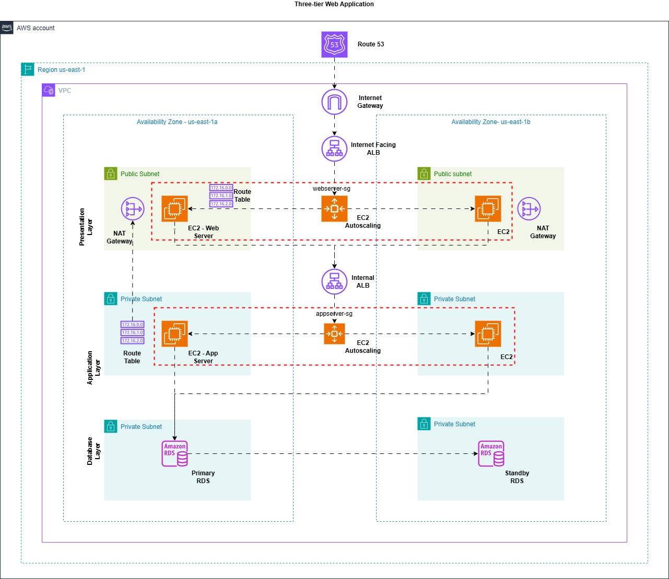
Architecture Diagram
Group Diagram

Slide 5
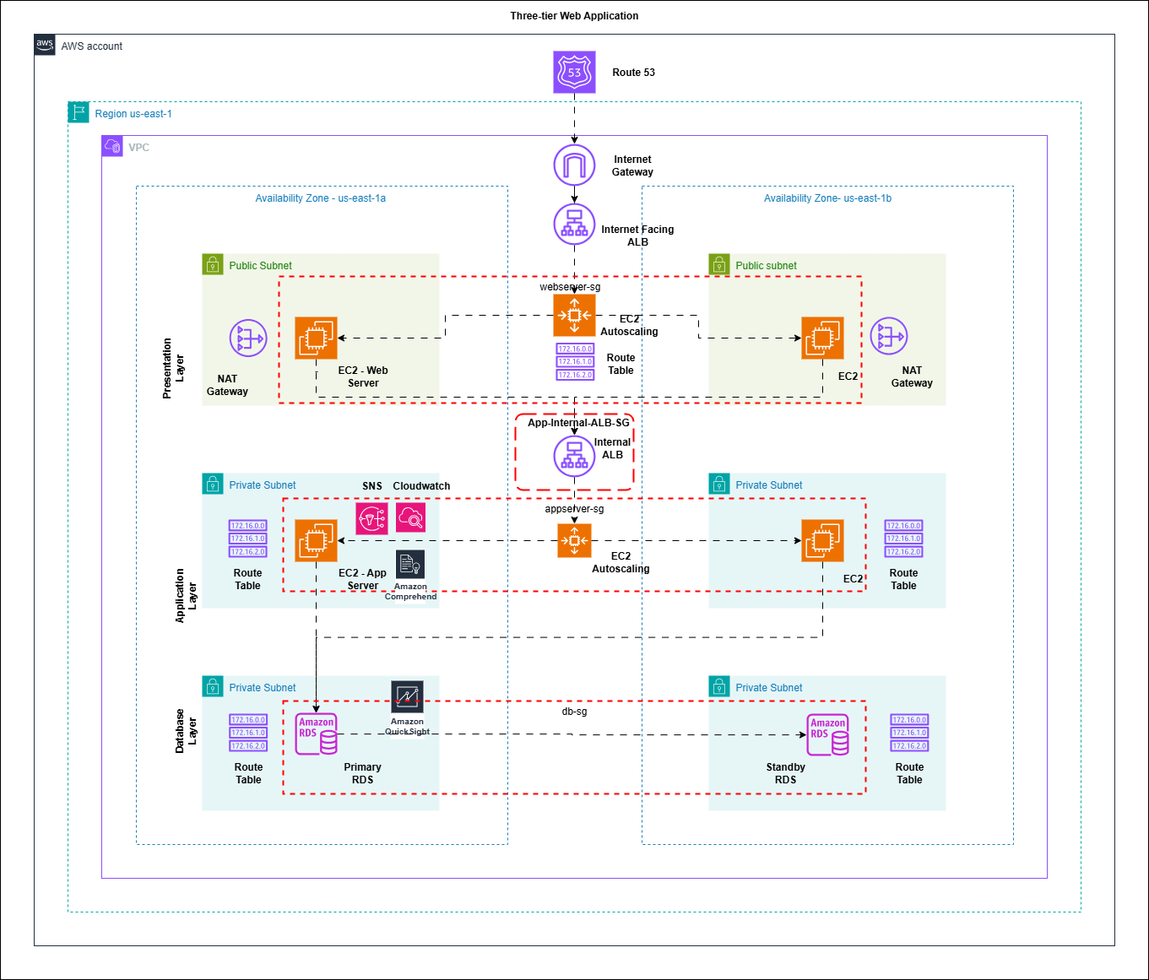
Architecture Diagram
Individual Diagram

Slide 6
AWS Resources
Amazon Route 53 – Manages domain name resolution, allowing users to access the system via a friendly URL.
Internet Gateway – Provides internet access for public-facing resources like web servers.
NAT Gateways – Allow private resources (application servers, database) to access the internet for updates without being publicly exposed.
Application Load Balancers – One internet facing ALB for the web tier and one internal ALB for the app tier to distribute traffic securely and perform health checks.
Amazon EC2 – Hosts the web frontend (Apache) and application backend (Flask).
Amazon RDS (MySQL) – Stores feedback data and sentiment analysis results securely.
AWS Comprehend – Performs sentiment analysis on feedback text.
Amazon QuickSight – Creates visualization dashboards showing trends and insights.
Amazon CloudWatch – Collects performance metrics and logs.
Amazon SNS – Sends notifications for scaling events and alarms.

Slide 7
Networking & Security
The application runs inside a dedicated VPC to ensure network isolation and security.
Subnet Design:
  2 Public Subnets – Host the web tier.
  2 Private Subnets – Host the application tier.
  2 Private Subnets – Host the database tier.
Security Groups:
  WebServer-SG – Allows HTTP, SSH, and HTTPS from the internet.
  AppServer-SG – Allows HTTP traffic only from the internal ALB.
  DB-SG – Allows MySQL traffic only from the AppServer-SG.

Slide 8
Auto Scaling & Load Balancing
The system uses Auto Scaling to maintain performance and optimize costs:
  WebServer-ASG – Launches or terminates web servers based on workload.
  AppServer-ASG – Scales backend application servers based on CPU usage.
  Scaling Policies – Target tracking on CPU utilization ensures the right number of instances are running.
Load Balancers:
  Internet facing ALB – Routes internet traffic to the Web Tier.
  Internal ALB – Routes traffic securely to the App Tier.
Alerts:
  Amazon SNS – Sends real-time notifications when scaling events occur.

Slide 9
AWS Comprehend & QuickSight
AWS Comprehend Integration:
  Detects sentiment in each feedback submission.
  Classifies feedback as Positive, Negative, and Neutral,.
  Integrated into the application tier backend so sentiment results are stored with the original feedback in RDS.
Amazon QuickSight Visualization:
  Connects securely to the RDS database via VPC connection.
  Displays sentiment trends, average ratings, and distribution charts in real time.
  Helps identify patterns and supports data-driven decision-making.

Slide 10
Monitoring & Alerts
Monitoring ensures the system remains healthy and responsive.
Amazon CloudWatch – Collects metrics such as CPU usage, memory, and network traffic.
CloudWatch Alarms – Trigger when thresholds are exceeded, e.g., high CPU usage.
Amazon SNS – Sends email notifications for scaling events or performance issues.

Slide 11
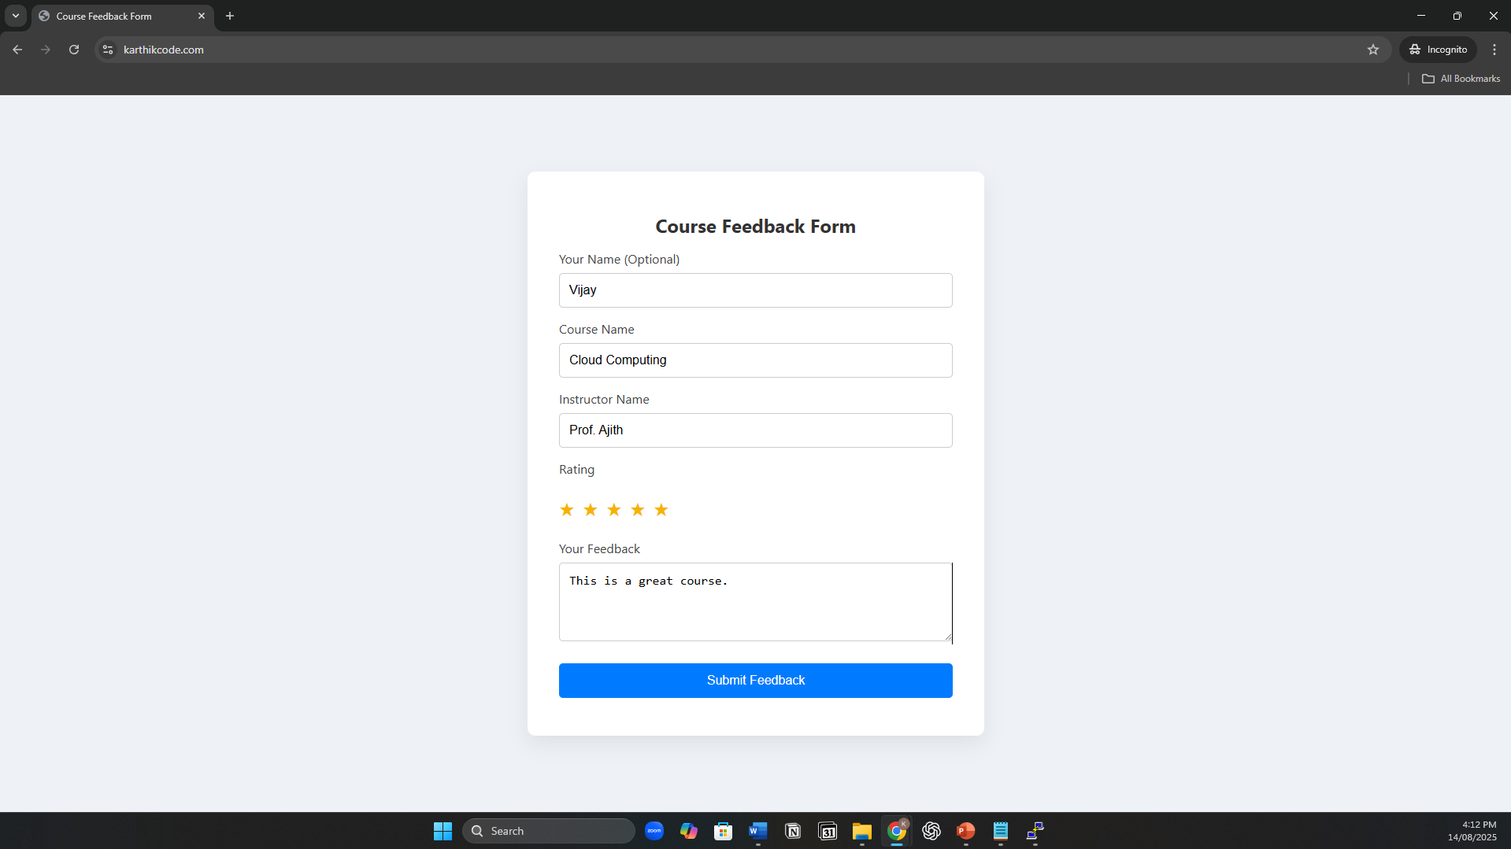
Website - https://karthikcode.com/

Slide 12
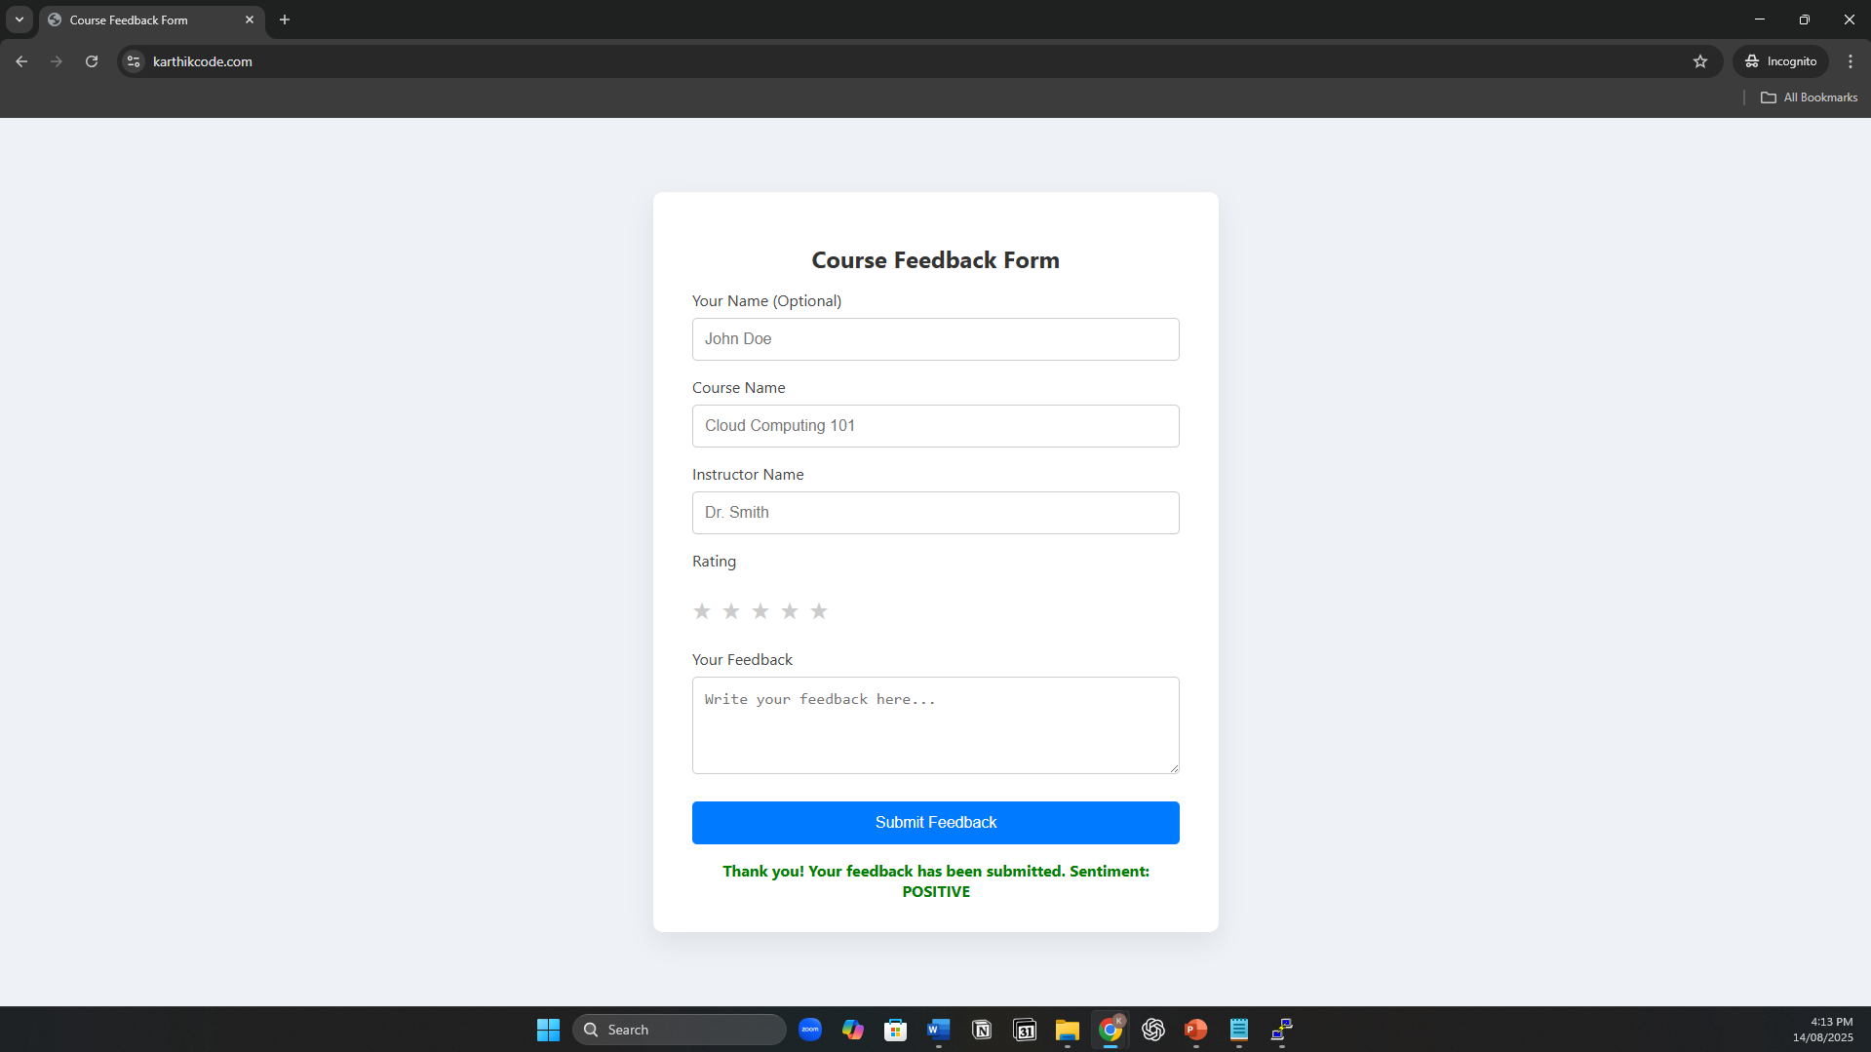
Website - https://karthikcode.com/

Slide 13
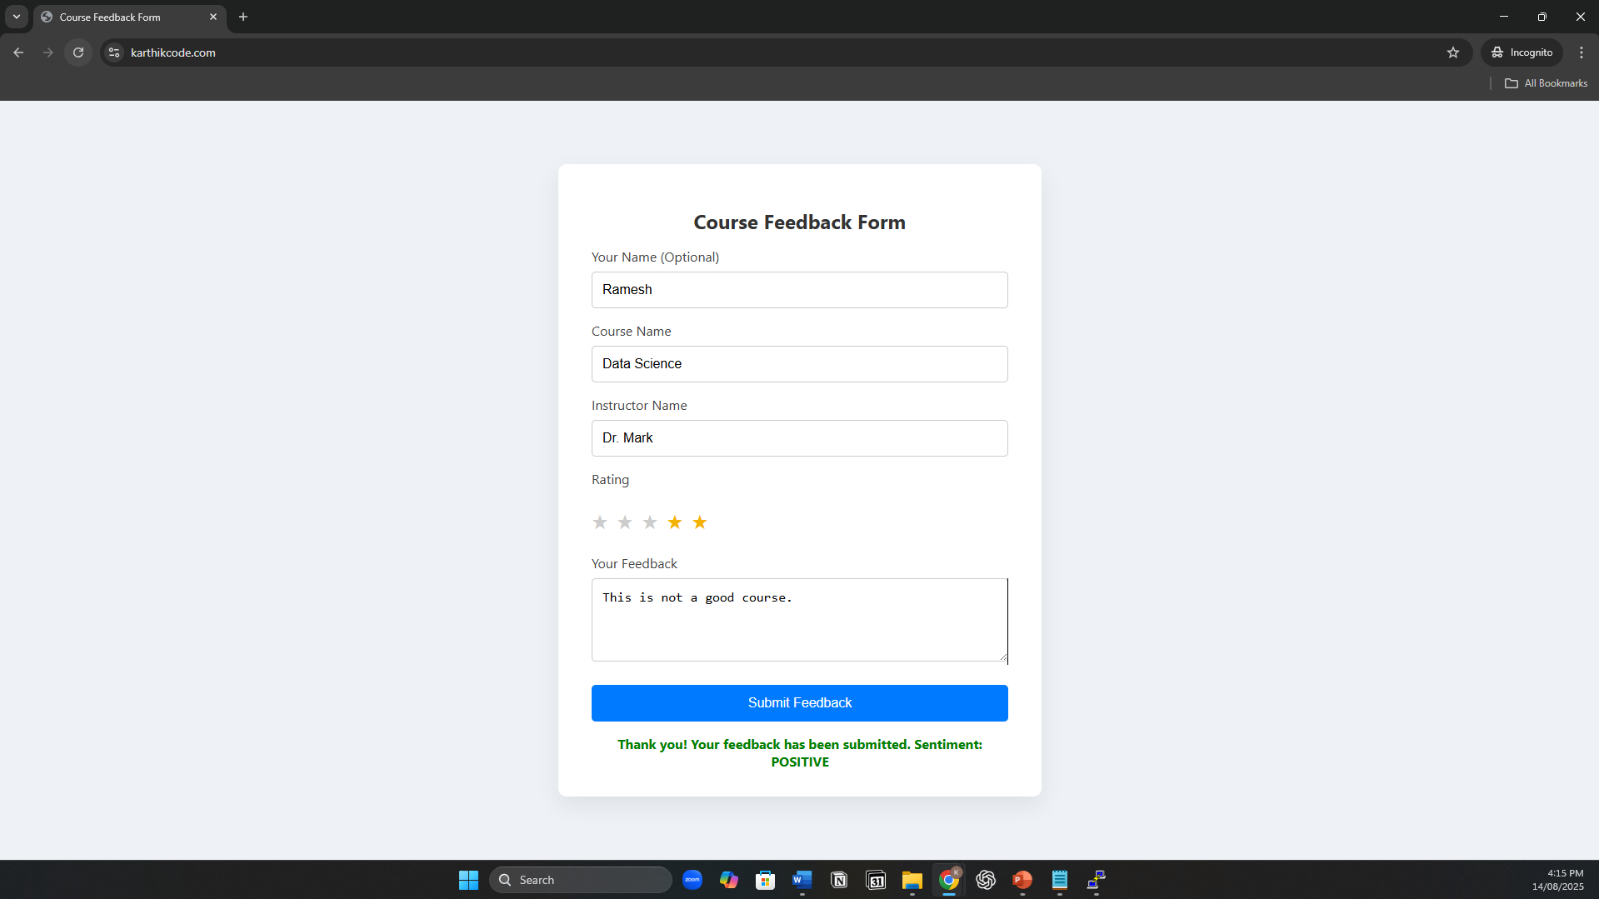
Website - https://karthikcode.com/

Slide 14

Website - https://karthikcode.com/

Slide 15
Live Demo https://karthikcode.com/

Slide 16
Thank You

